Slide 1
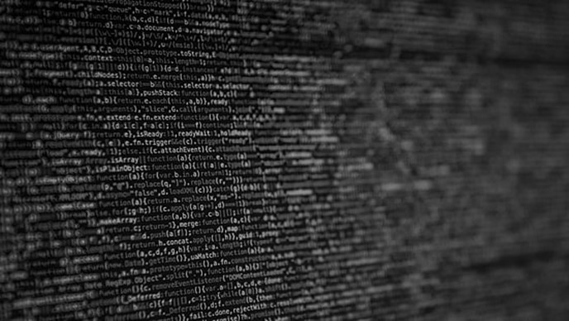
Project White Spectra
By Nikodem Drabik

Slide 2
Project
Vision
Notes:
Create a single page application that with navigation for those who struggle to understand the internet and how to navigate it safely.
Reasons for choosing people who struggle:
No current substitutes on the market. No company created such webpage
Mass amount of vulnerable people taken advantage of on the internet
This creates an almost 100% secure environment if the users end up using this webpage
The following points will be expaned on in the next sliedes

Slide 3
Project Vision
Project Idea:
Create a Single Page Application that helps with internet navigation
This Project Will:
Be Designed for people who struggle with the internet
Allow user to navigate the internet with ease and better security.
Have a Secure password creator.
Section dedicated to E-Saftey
Have Google’s search engine API.
Notes:
Create a single page application that with navigation for those who struggle to understand the internet and how to navigate it safely.
Reasons for choosing people who struggle:
No current substitutes on the market. No company created such webpage
Mass amount of vulnerable people taken advantage of on the internet
This creates an almost 100% secure environment if the users end up using this webpage
The following points will be expaned on in the next sliedes

Slide 4
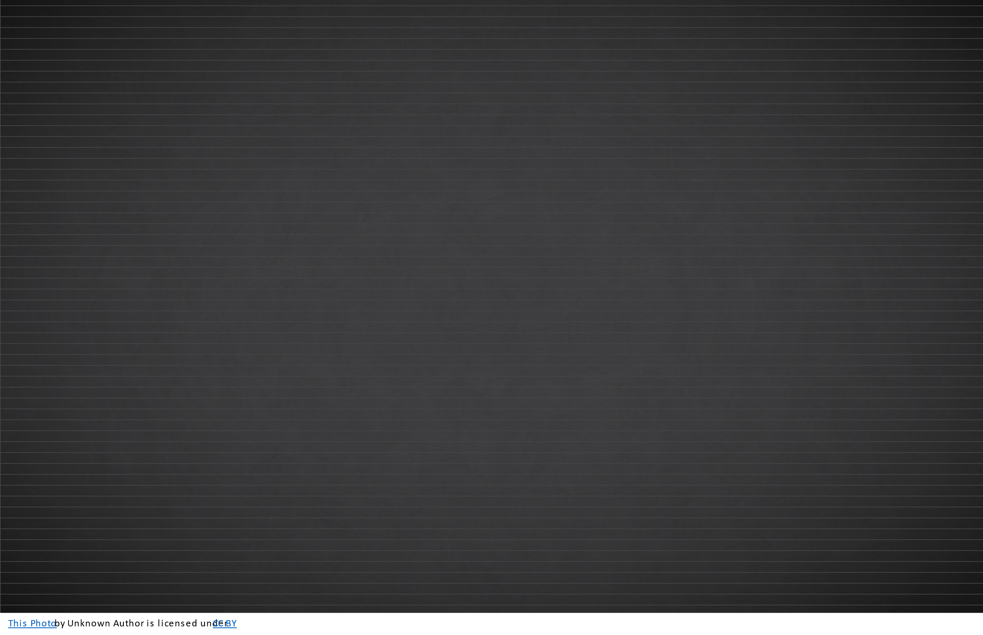


Website hub
Features:
Icons that Connect to websites such as:
Facebook
Emails
Bank – Quite important
Shopping
E-Safety Section:
Useful Recourses
Cyber Security Websites
Website featuring everyday tools.
Design Influence:
Users – Elderly
Children
Tech inept
Neurodivergent
Readability – Eyesight
Ease of Use
Eye appealing design
Versatility
Notes:
Design Influence
Readability - Old people struggle to sea
The design needs to be straight forward no over the top complicated inputs.
Eye appealing design as if the design is not well composed the users will not enjoy using it for example old iPhone Operating System compared to new IOS
Due to my intended use I want it to be able to be used by the different skill and age level of possible users this means-
May add ability to change websites – increase decrease amount displayed
Mobile Compatible
Low Processing Power- users may be using outdated devices

Slide 5
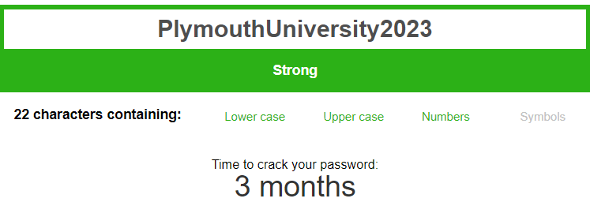
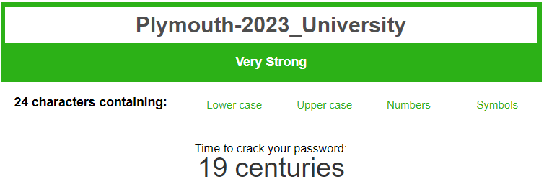
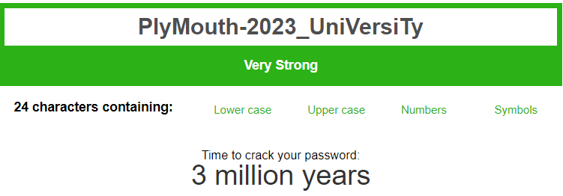
Password Creator
Encryption
Data inputted -> Plymouth University 2023 No Special Encryption
Foreseen Problems:
English Language – Syllable Separation
User logic
Security – Brute Force
Basic Generated Password -> Plymouth-2023_University First letter of each word
Strongest Generated Password -> PlyMouth-2023_UniVersiTy
Syllable Separation
Password Management:
Storage
Security
User Preferability
Notes:
Idea:
Section of SPA
To have the user input the 2-3 words and 1 string of didits that have some kind of meaning to them to make it easier to remember;
That data will be scrambled hopefully by –
Hopefully, Syllables = Capitalised
Special Characters - _ @
Numbers integrated
Show better than basic input- future more computer power -> faster brute force -> long-term password == better
Issues:
User lack of skill - May lead to weak passwords
Syllables- Difficult to imitate the English language in code -> possibly impossible on such a small scale
Brute Force == Long Time / With my password generating logic -> weak
Password Management:
Storage -> Currently uses notepad stored in a cupboard can be bad or good regarding security
Other ways of storage is on user device depending how it is done can depend on security level.
User Preference -> User prefers to store it physically. Have it in hand .

Slide 6
Google Search API
Further Searches are $5 per 1000
Ads to cover the cost
Language: JSON
Uses: Allows User to search in the SPA
Cost: Free 100 searches per day.
Future application requirements:
Notes:
Allows user to use google search engine from my website sending them to the destination they searched for.
API

Slide 7
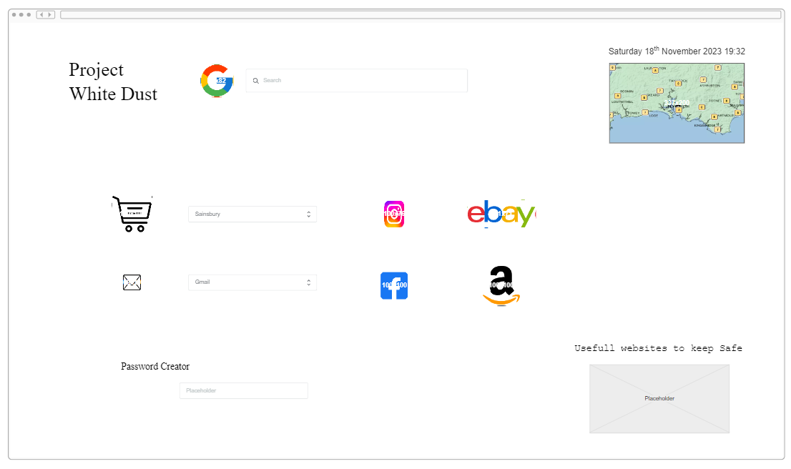
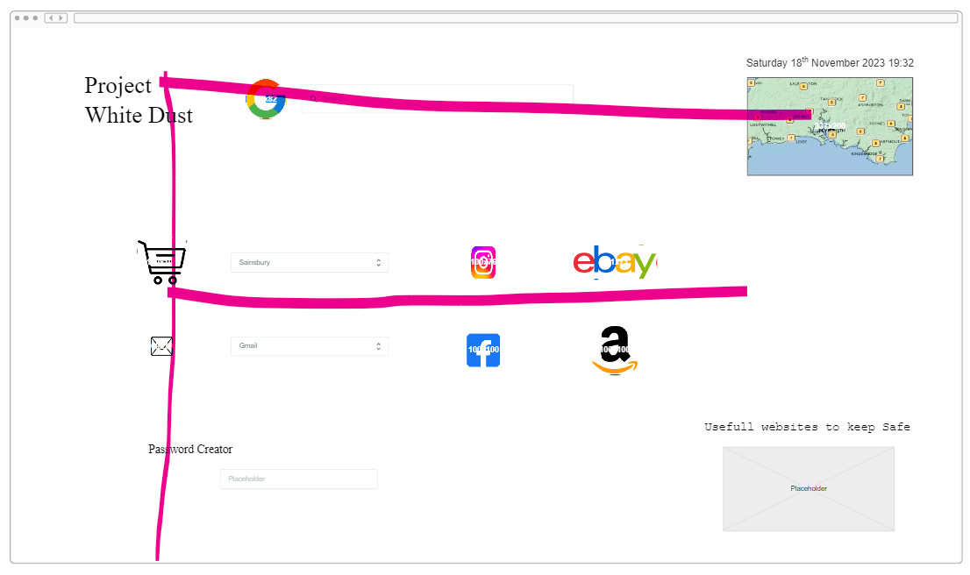

Sprint 1
Breaking Down Idea and Creating first prototype
- Prototype 1
Improvement:
Layout
Low information
Design style in correlation with Human eye Tracking

